Slide 1
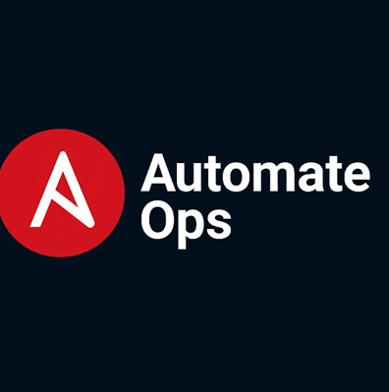
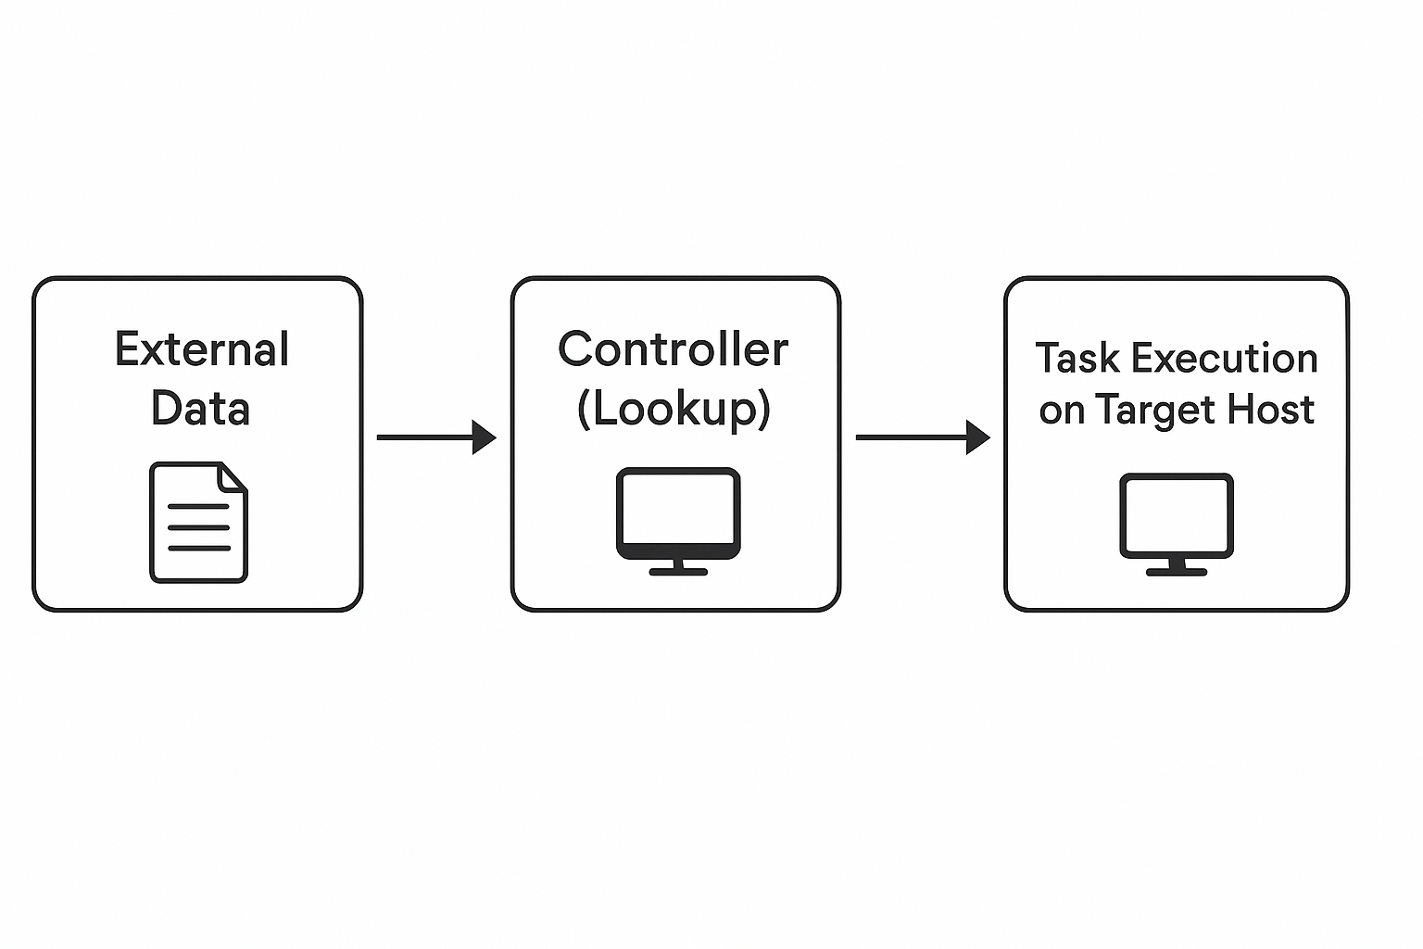
Where lookup runs vs where task runs
Understanding Ansible Lookup Plugins
A Practical Deep Dive
What lookup plugins are and where they run
Why lookups matter in automation (dynamic data, no hardcoding, external integrations)
Difference between lookup() and query()
Real‑world examples: file, env, pipe, template lookups
Mini demonstration of combining multiple lookup plugins
Comparison of lookup vs vars_file vs templates

Slide 2
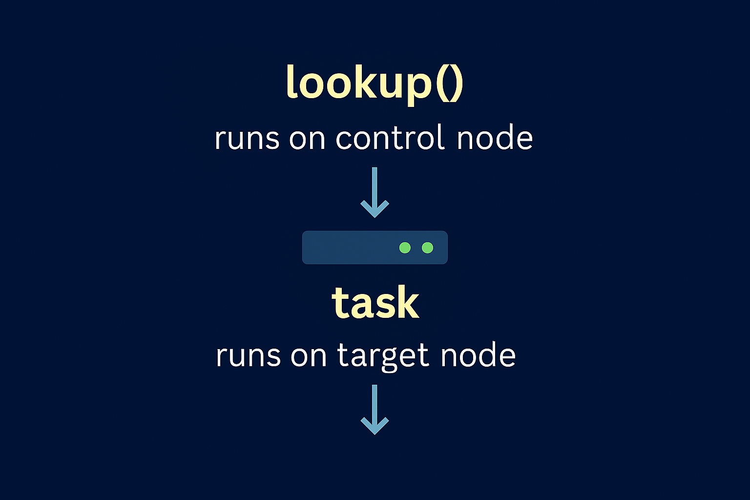
Where lookup runs vs where task runs

Slide 3
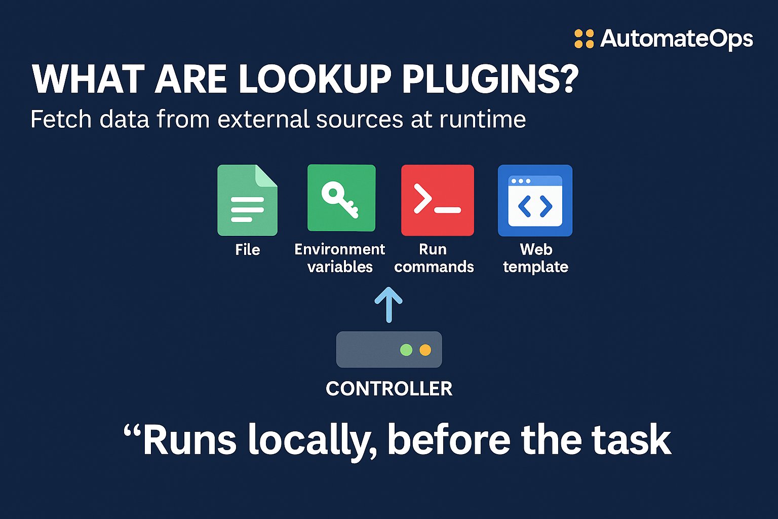
Ansible Lookup Plugins — Basics
Lookup plugins help Ansible fetch data from external sources at runtime.
They run on the controller, not on remote machines.
This is important — because it means lookups always happen locally, before the task runs on the target host.
Think of lookup plugins as Ansible’s way of pulling information into the playbook instead of hardcoding it.
Fetch external data dynamically
Files, env vars, commands, templates

Slide 4
Why Use Lookup Plugins?
Avoid hardcoding.
Sensitive values like secrets, IP addresses, API tokens — keep them outside the playbook.
Make playbooks dynamic
Different environments — dev, QA, prod — require different configurations.
Integrate with external systems.
Files, URL endpoints, Vault, cloud metadata, environment variables, and shell commands.
Other use cases:
Keeps secrets out of Git
Useful with CI/CD pipelines”
Lookups make playbooks reusable, portable, and easier to maintain

Slide 5
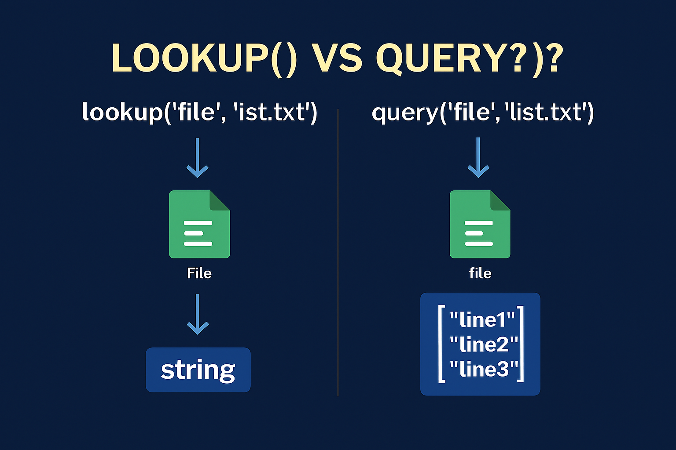
lookup() vs query()
lookup() → string
query() → list
Use query() for loops
Real world example: lookup for single item, query for multi-line file or list.

Slide 6
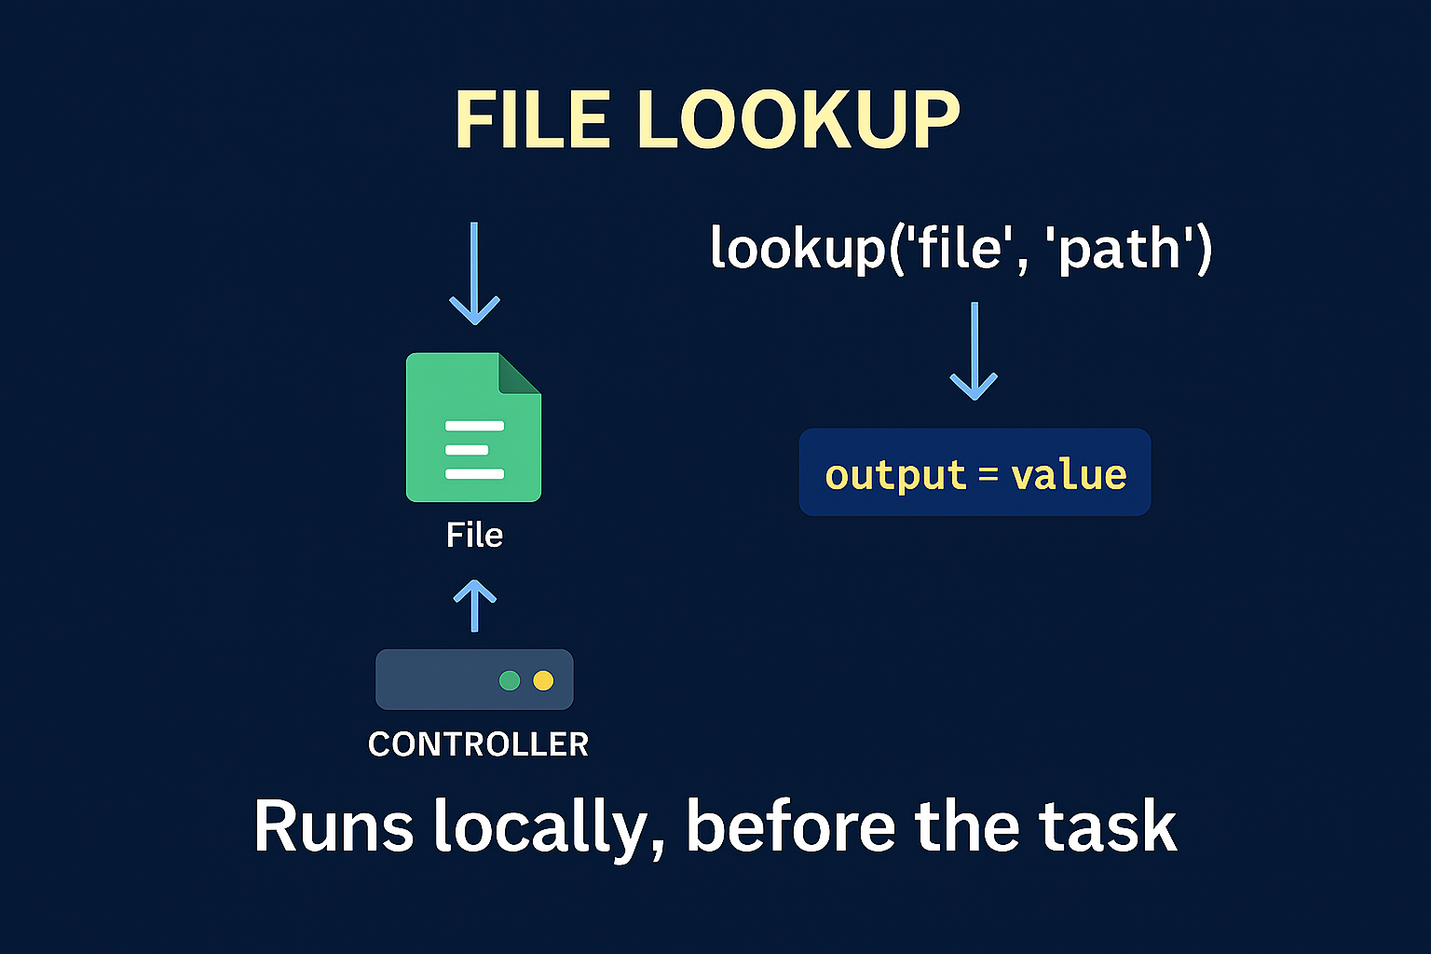
File – lookup
Combine file + env + pipe lookups
Dynamic automation example
vars:
motd: "{{ lookup('file', 'files/motd.txt') }}
- name: Show MOTD
debug:
msg: "{{ motd }}"

Slide 7
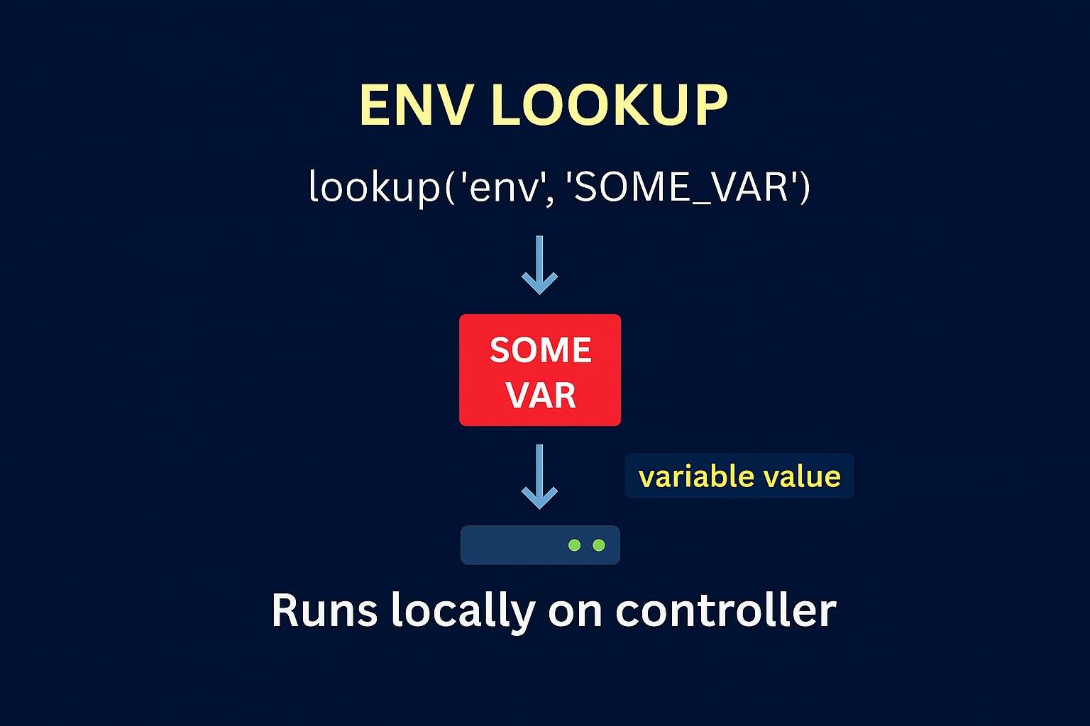
env – lookup
The env lookup plugin fetches environment variables from the Ansible controller.
This is helpful when your controller has environment‑specific values
Example:
1. deploy_env: "{{ lookup('env', 'DEPLOY_ENV') or 'dev' }}“
2.db_pass: "{{ lookup('env', 'DB_PASSWORD') | default('changeme', true) }}"

Slide 8
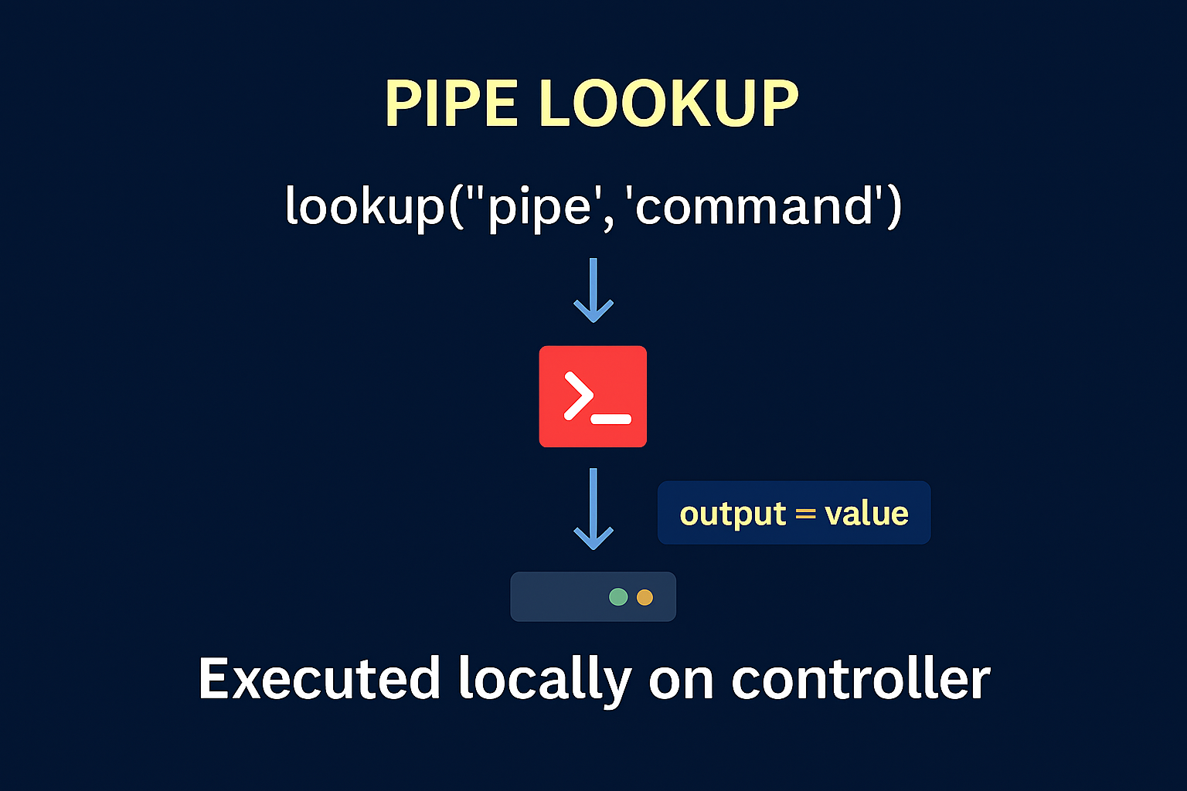
pipe – lookup
Read output from a command
Like all lookups this runs on the Ansible controller and is unaffected by other keywords, such as become, so if you need to different permissions, you must change the command or run Ansible as another user.
Alternatively, you can use a shell/command task that runs against localhost and registers the result.
The directory of the play is used as the current working directory.
Example:
==============================================
short_date: "{{ lookup('pipe', 'date +%F', errors='ignore') or '1970-01-01' }}"
==============================================

Slide 9
Mini Demo
Combine file + env + pipe lookups
Dynamic automation example
vars:
motd: "{{ lookup('file', 'files/motd.txt') }}"
deploy_env: "{{ lookup('env', 'DEPLOY_ENV') or 'dev' }}"
today: "{{ lookup('pipe', 'date +%F') }}“

Slide 10
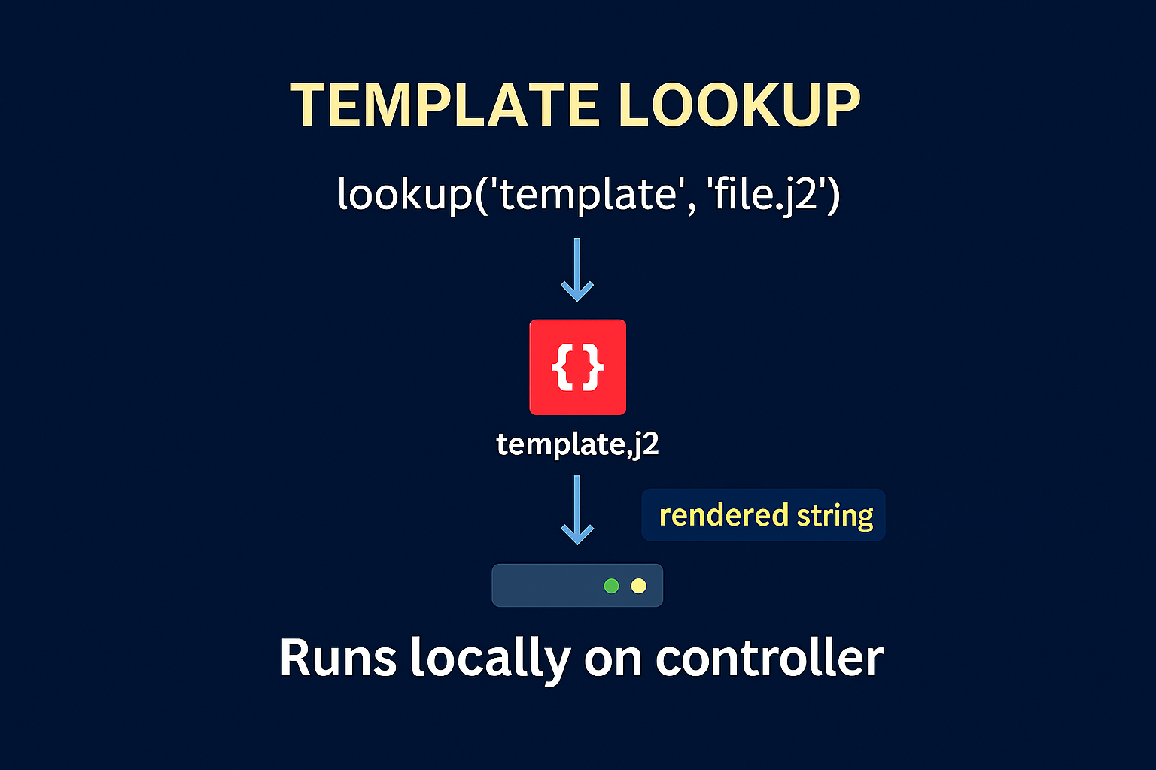
template – lookup
The template lookup renders a Jinja2 template into a string — without writing a file.
This is extremely useful for generating small dynamic configuration blocks
File.j2:
{% for k, v in settings.items() %}
{{ k }}={{ v }}
{% endfor %}
===============
ansible.builtin.debug:
msg: "{{ lookup('template', 'templates/snippet.j2') }}
===============

Slide 11
lookup vs vars_file vs templates
Lookup | Purpose
lookup( file) | RAW text
vars_files | YAML variable
template module | Writes renders files remotely
Template lookup | Renders string only

Slide 12
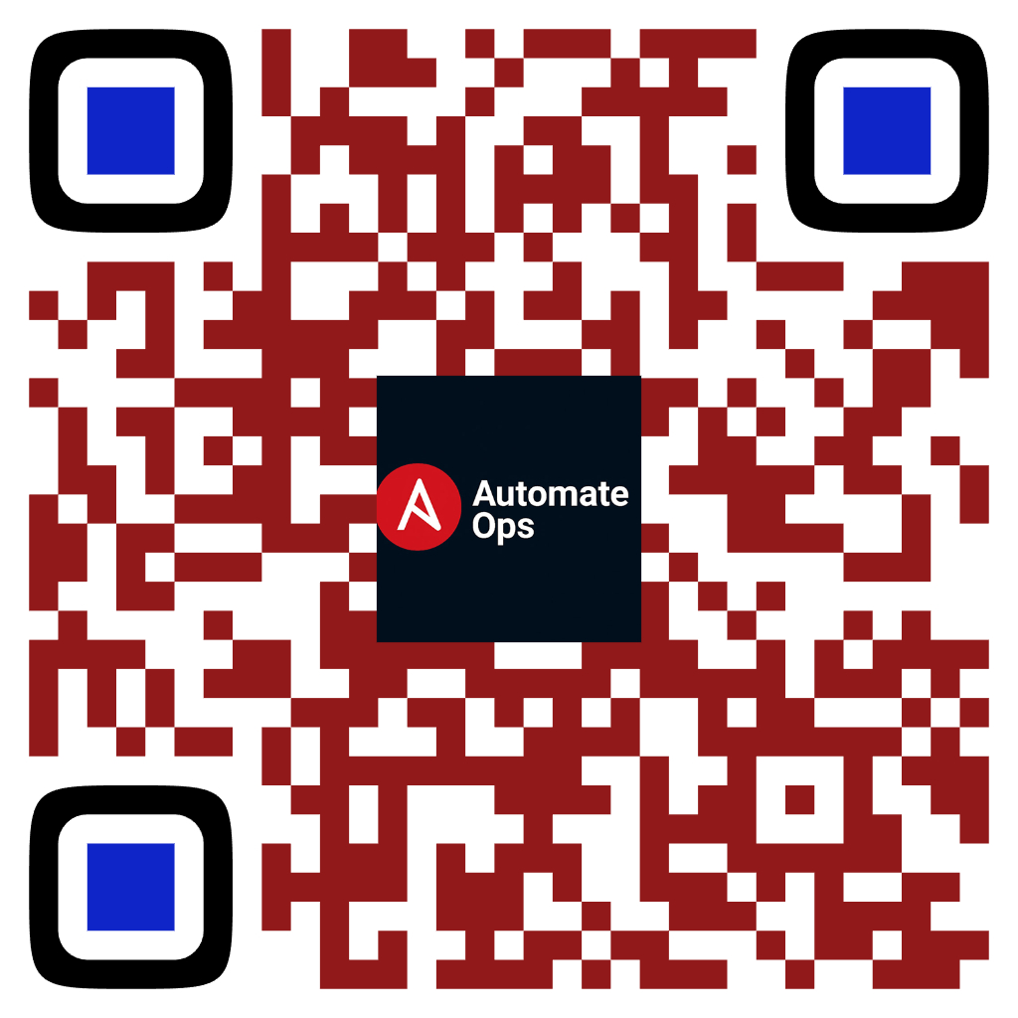
Where lookup runs vs where task runs
Key Takeaways — Lookup Plugins in Action
Lookup plugins always run on the controller, not the target
Great for injecting dynamic data into playbooks
Helps avoid hardcoding and supports environment‑specific values
Use lookup() for strings, query() for lists
Combine multiple lookups (file + env + pipe) for powerful automation
Template lookup is ideal when you want dynamic text without writing files
Scan to Subscribe
Up Next:
• url
• ini
• fileglob
• password
• first_found
• and more — with real-world demos and best practices

